Slide 1

DBSCAN

Slide 2
DBSCAN
DBSCAN - Density-based spatial clustering of applications with noise is a powerful technique which can be used for clustering and outlier detection.
Let’s review what this section will cover!

Slide 3
DBSCAN
Section Overview:
Intuition of DBSCAN
DBSCAN vs. K-Means Clustering
DBSCAN Hyperparameters Theory
DBSCAN Hyperparameters Coding
Outlier Project Exercise
Project Solutions

Slide 4
Let’s get started!

Slide 5
DBSCAN
Theory and Intuition

Slide 6
DBSCAN
DBSCAN stands for Density-based spatial clustering of applications with noise.
Let’s review a brief history of the algorithm and then explore an intuition based approach to understanding how it works.

Slide 7
DBSCAN
1972: Robert F. Ling published a closely related algorithm in "The Theory and Construction of k-Clusters" with an expected run time of O(n³).
This means that as n number of points grows, the run time of the algorithm grows cubically!

Slide 8
DBSCAN
1996: Martin Ester, Hans-Peter Kriegel, Jörg Sander and Xiaowei Xu proposed the modern version of DBSCAN with a runtime of O(n²).
2014: DBSCAN was awarded the test of time award at the leading data mining conference, SIGKDD.

Slide 9
DBSCAN
Questions to consider:
How does DBSCAN work?
Advantages and disadvantages of DBSCAN?
How does it deal with outliers and noise?

Slide 10
DBSCAN
DBSCAN Key Ideas
DBSCAN focuses on using density of points as its main factor for assigning cluster labels.
This creates the ability to find cluster segmentations that other algorithms have difficulty with.

Slide 11
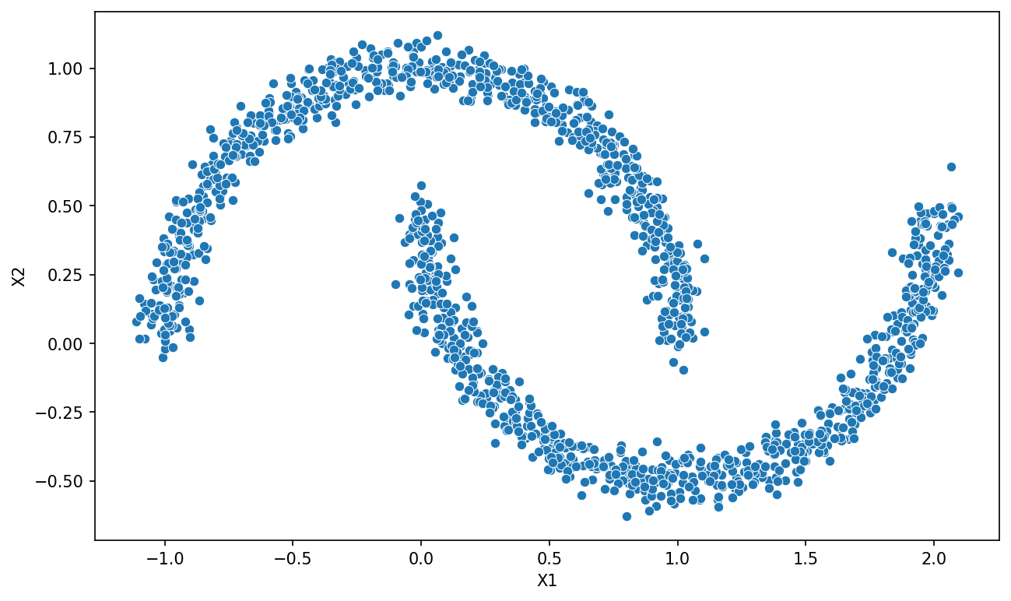
DBSCAN
Consider the following data set:

Slide 12
DBSCAN
Cleary two “moon” shaped clusters:

Slide 13
DBSCAN
But distance based clustering has issues:

Slide 14
DBSCAN
But distance based clustering has issues:

Slide 15
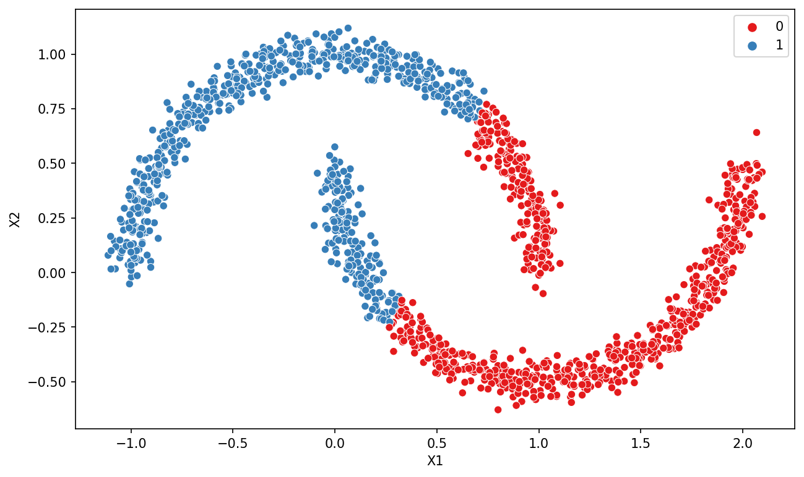
DBSCAN
Results of K-Means:

Slide 16
DBSCAN
Results of DBSCAN:

Slide 17
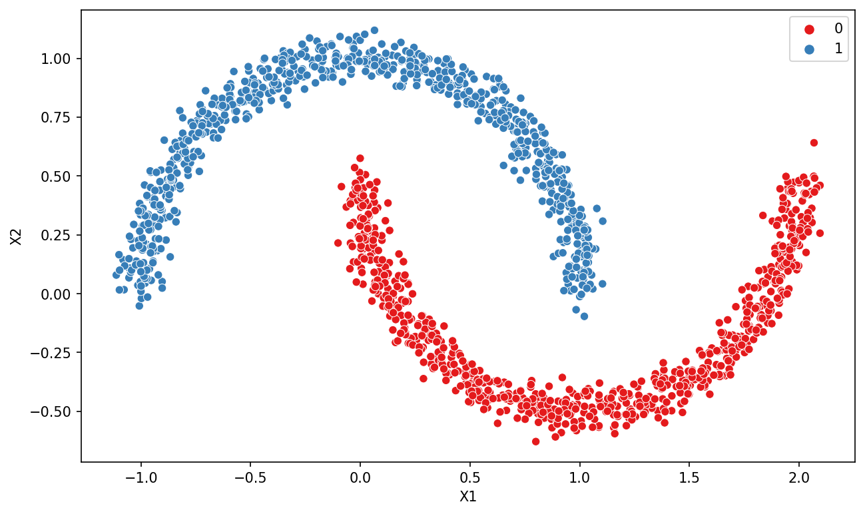
DBSCAN
Results of DBSCAN:

Slide 18
DBSCAN
DBSCAN iterates through points and uses two key hyperparameters (epsilon and minimum number of points) to assign cluster labels.
Unlike K-Means, it focuses on density as the main factor for cluster assignment of points.

Slide 19
DBSCAN
DBSCAN Key Hyperparameters:
Epsilon:
Distance extended from a point.
Minimum Number of Points:
Minimum number of points in an epsilon distance.

Slide 20
DBSCAN
DBSCAN Point Types:
Core
Border
Outlier

Slide 21
DBSCAN
DBSCAN Point Types:
Core
Border
Outlier

Slide 22
DBSCAN
DBSCAN Point Types:
Core

Slide 23
DBSCAN
DBSCAN Point Types:
Core
ε = 1

Slide 24
DBSCAN
DBSCAN Point Types:
Core
ε = 1 and Min Points = 2

Slide 25
DBSCAN
DBSCAN Point Types:
Core
ε = 1 and Min Points = 2

Slide 26
DBSCAN
DBSCAN Point Types:
Core:
Point with min. points in epsilon range.
ε = 1 and Min Points = 2

Slide 27
DBSCAN
DBSCAN Point Types:
Core:
Point with min. points in epsilon range.
ε = 1 and Min Points = 2
Core

Slide 28
DBSCAN
DBSCAN Point Types:
Core:
Point with min. points in epsilon range (including itself).
ε = 1 and Min Points = 3
Core

Slide 29
DBSCAN
DBSCAN Point Types:
Border:
In epsilon range of core point, but does not contain min. number of points.
ε = 1 and Min Points = 3

Slide 30
DBSCAN
DBSCAN Point Types:
Border:
In epsilon range of core point, but does not contain min. number of points.
ε = 1 and Min Points = 3
Core

Slide 31
DBSCAN
DBSCAN Point Types:
Border:
In epsilon range of core point, but does not contain min. number of points.
ε = 1 and Min Points = 3
Border

Slide 32
DBSCAN
DBSCAN Point Types:
Border:
In epsilon range of core point, but does not contain min. number of points.
ε = 1 and Min Points = 3
Border
Core

Slide 33
DBSCAN
DBSCAN Point Types:
Outlier:
Can not be “reached” by points in a cluster assignment.
ε = 1 and Min Points = 3

Slide 34
DBSCAN
We will discuss neighborhoods, epsilon, and minimum number of points in further detail later on, but let’s review the actual process of DBSCAN for assigning clusters.

Slide 35
DBSCAN
DBSCAN Procedure:
Pick a random point not yet assigned.
Determine the point type.
Once a core point has been found, add all directly reachable points to the same cluster as core.
Repeat until all points have been assigned to a cluster or as an outlier.

Slide 36
DBSCAN
Let’s explore a useful visualization of the procedure!

Slide 37
DBSCAN
Coding Example on Data Sets

Slide 38
DBSCAN
Let’s explore how DBSCAN compares to K-Means clustering on some unique data sets to get an intuitive understanding of the density based approach of DBSCAN versus a distance based clustering approach of K-Means.

Slide 39
DBSCAN
Key Hyperparameters

Slide 40
DBSCAN
As we’ve seen already, there are two key hyperparameters to consider for DBSCAN:
Epsilon:
Distance extended from a point to search for Min. Number of Points.
Min. Number of Points:
Min. Number of Points within Epsilon distance to be a core point.

Slide 41
DBSCAN
Adjusting these hyperparameters have two main outcomes:
Changing number of clusters.
Changing what is an outlier point.

Slide 42
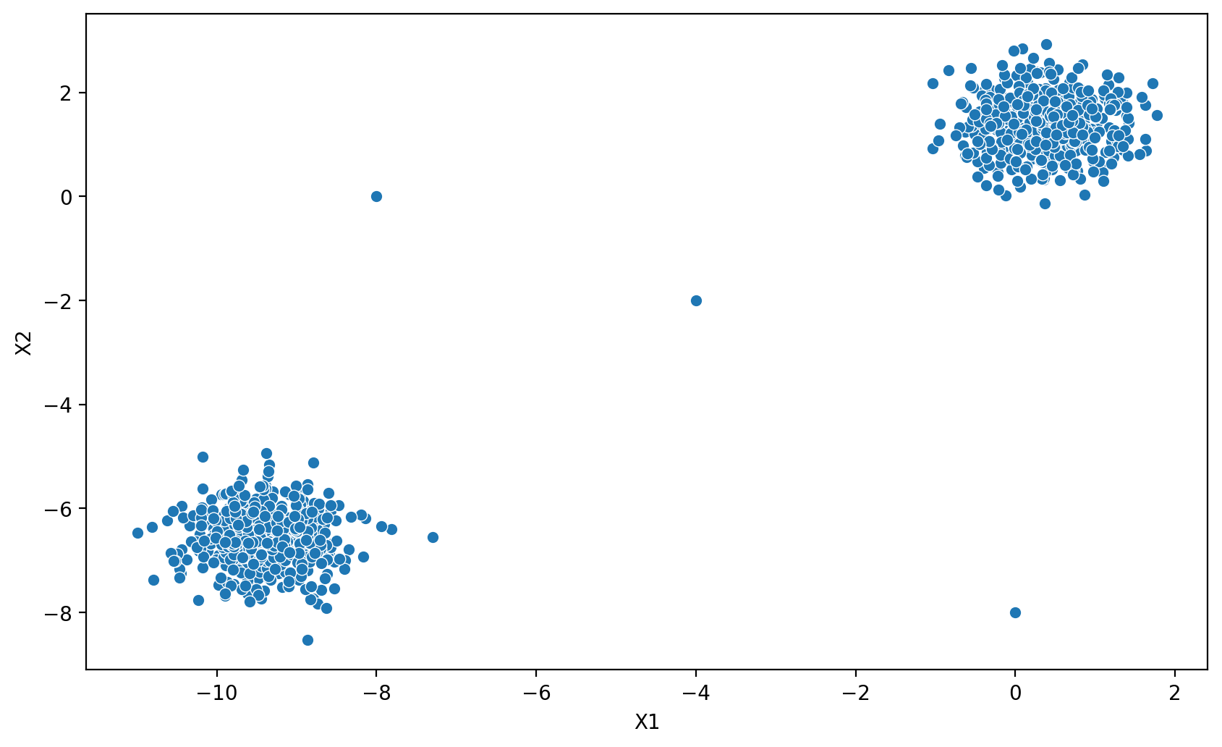
DBSCAN
Example Data Set:

Slide 43
DBSCAN
Example Data Set:

Slide 44
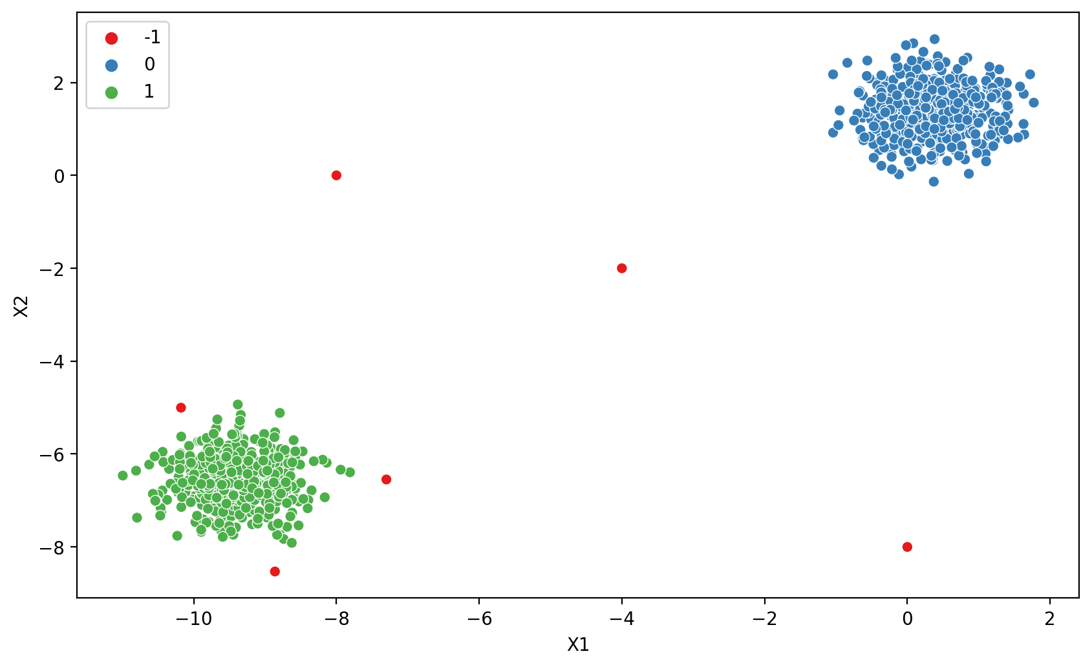
DBSCAN
DBSCAN Results:

Slide 45
DBSCAN
DBSCAN Results:

Slide 46

DBSCAN
DBSCAN Results:

Slide 47
DBSCAN
Epsilon Intuition:
Increasing epsilon allows more points to be core points which also results in more border points and less outlier points.
Imagine a huge epsilon, all points would be within the neighborhood and classified as the same cluster!

Slide 48
DBSCAN
Epsilon Intuition:
Decreasing epsilon causes more points not to be in range of each other, creating more unique clusters.
Imagine a tiny epsilon, the range would not extend far out enough to come into contact with any other points!

Slide 49
DBSCAN
Methods for finding an epsilon value:
Run multiple DBSCAN models varying epsilon and measure:
Number of Clusters
Number of Outliers
Percentage of Outliers

Slide 50
DBSCAN
Methods for finding an epsilon value:
Extremely dependent on the particular data set and domain space.
Requires user to have some expectation or intuition about number of clusters and relative percentage of outliers.

Slide 51
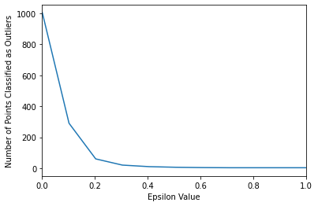
DBSCAN
Plot “elbow/knee” diagram comparing epsilon values:

Slide 52
DBSCAN
Minimum Number of Samples/Points:
Number of samples in a neighborhood for a point to be considered as a core point (including the point itself).

Slide 53
DBSCAN
Min. Number of Samples Intuition:
Increasing to a larger number of samples needed to be considered a core point, causes more points to be considered unique outliers.

Slide 54
DBSCAN
Min. Number of Samples Intuition:
Imagine if min. number of samples was close to total number of points available, then very likely all points would become outliers.

Slide 55
DBSCAN
Choosing Min. Number of Samples:
Test multiple potential values and chart against number of outliers labeled.

Slide 56
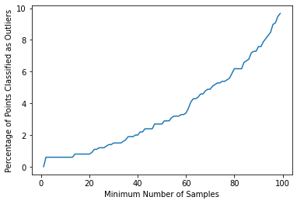
DBSCAN
Choosing Min. Number of Samples:
Test multiple potential values and chart against number of outliers labeled.

Slide 57
DBSCAN
Min. Number of Samples Note:
Useful to increase to create potential new small clusters, instead of complete outliers.

Slide 58
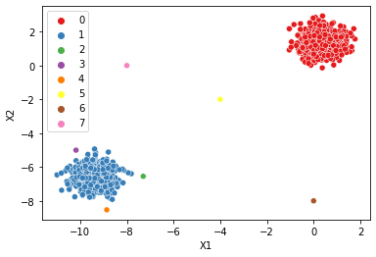
DBSCAN
Min. Number of Samples Note:
Useful to increase to create potential new small clusters, instead of complete outliers.

Slide 59
DBSCAN
Let’s continue by exploring hyperparameters with code and data examples!

Slide 60
DBSCAN
Hyperparameter Search

Slide 61
DBSCAN
Project Exercise Overview

Slide 62
DBSCAN
Project Exercise Solutions

